Slide 1

Introduction to IT & Cybersecurity
The Art of Manhood Mentoring Workshop

Slide 2

Workshop Agenda
  Icebreaker: What is IT? (15 minutes)
  Overview of IT and Cybersecurity (30–45 minutes)
  Team Activity: Build a Simple Security Plan
  Career Pathways & Q&A

Slide 3

What is Information Technology?
  IT involves managing and supporting computer systems and networks
  Covers hardware, software, data, networking, and user support, & customer service
  Critical for every modern organization
  It is a great way to provide value and serve your community

Slide 4
What Does an IT Project Manager Do?
Plan and coordinate technology projects
1
Work with technicians, clients, and leadership
2
Ensure successful delivery of IT solutions
3
Communicate goals, expectations, and timelines
4

Slide 5
What is Cybersecurity?
Protecting systems, networks, and data from attacks
Involves risk management, monitoring, and incident response
Cybersecurity professionals help keep organizations safe

Slide 6
Basic Concepts to Know
Confidentiality, Integrity, Availability
Malware and phishing
Strong passwords and MFA
Network security basics

Slide 7
Team Activity: Build a Security Plan
Break into small groups
Each team designs a security plan for a fictional business
Identify: assets, threats, protections
Teams share their solutions

Slide 8
IT & Cybersecurity Career Pathways
• IT Support
• Systems Administration
• Cybersecurity Analyst
• Network Engineer
• Project Manager
• Cloud Specialist
• Industry Certifications (Comptia Trifecta) Degree’s, Salary expectations.

Slide 9

How to Identify Phishing Emails
  Check the sender’s email address
  Beware of urgent or threatening language
  Hover over links before clicking
  Look for spelling or grammar mistakes

Slide 10
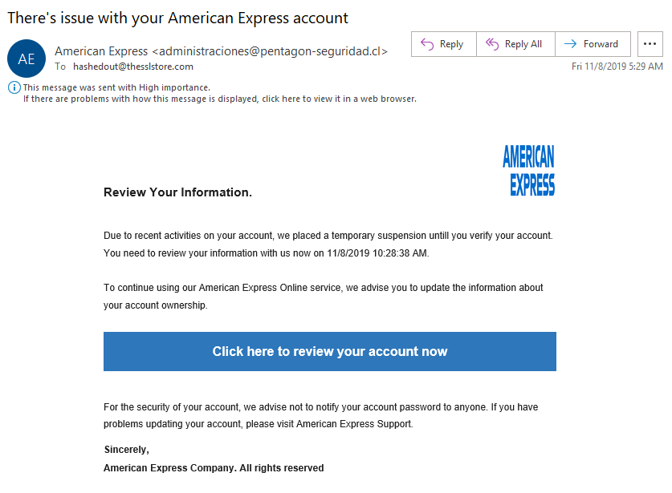

Phishing Email Example

Slide 11
How MFA Works
Step 1: Something you KNOW (password)
Step 2: Something you HAVE (phone or authenticator code)
Even if your password is stolen, the hacker still cannot log in

Slide 12

MFA Demonstration
  Show a sample login screen
  Explain rotating 6-digit codes
  Explain why MFA blocks most attacks

Slide 13

Closing & Open Q&A
Questions, Thoughts, or Ideas?
  What did you learn today?
  What part of IT or Cybersecurity interests you the most?
  Any questions about careers, skills, or next steps?

